Slide 1
Financial Information System
Change Network | May 2019

Slide 2
Change Network Topics
1 | Staff Webinar- Q&A Session
2 | Engagement Tracking
3 | Department Meeting Request Process
4 | Phase 2- Project Configuration and Implementation
5 | Expanding Department Participation
6 | Downstream Inventory Assessment
7 | Next Up: Procurement, T/E, Reporting and Analytics Strategy

Slide 3
Staff Webinar- Chart of Accounts
The Financial Information System team talks about the new Chart of Accounts then answers questions from the online audience: https://youtu.be/y_NtOMl5oz8
Questions/feedback from the field (your teams)?
Chart of Accounts FAQ’s on-line by May 17th.

Slide 4
Engagement Tracking
The Engagement Tracking Form serves two purposes:
The tracker captures active participation by local sponsorship coalition members
Project engagement metrics are reported to Sponsors and Governance monthly
# Areas

Slide 5
Engagement Tracking Going Forward
Continue self-reporting
Send end of month reminder via list-serv(s)
First 5+ minutes of monthly meeting to review/complete
1
2
3
SUCCESS!

Slide 6
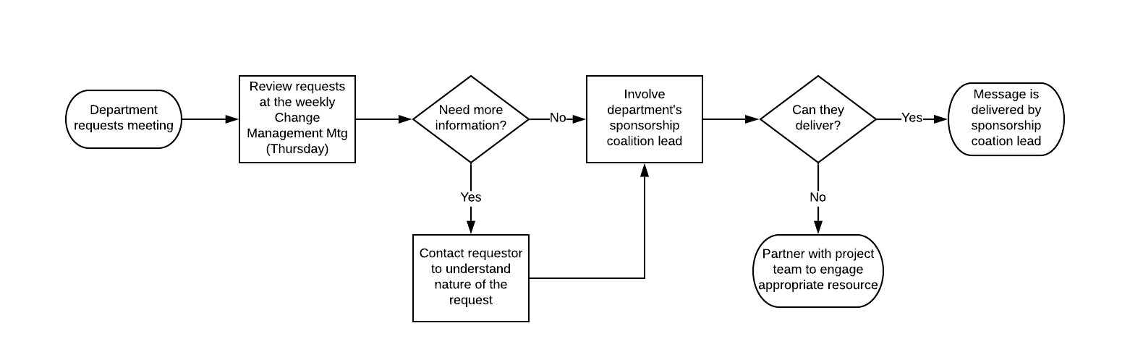
Request Process

Slide 7
Configuration and Implementation Workstreams
Q4
Q1
April
May
June
July
August
Sept
Common Chart of Accounts
CCoA Conversion Strategy
Chart of Accounts Mapping
Alignment with Business Process in OFC
Analytics and Reporting
Financial Data Business Requirements (Downstream Process Inventory Assessment)
FIS Reporting and Analytics Strategy Governance Review/Approval
Design Lead/Entity BI requirements and reporting priority feedback
BI & Reporting
Design and Configuration
Design and Configuration
Design Lead Oracle Training and Certification
Future State Process Design and Configuration
Conversion and Functional Testing
Data Conversion Strategy
Data Conversion
Technical Implementation
Environment Strategy
Configuration
Data Use Inventory, Stakeholder Business Objective, Remediation and Integrations
Quality Assurance: Data Conversion, Integration, and Functional Testing

Slide 8
UCSD Oracle Cloud – Process Design Workshop Schedule – Week 1 (will continue for 8 weeks through July)
 | May 6 | May 7 | May 8 | May 9 | May 10
Time | Monday | Tuesday | Wednesday | Thursday | Friday
08:00am – 09:00am
09:00am – 10:00am
10:00am – 11:00am
11:00am – 12:00pm
12:00pm – 01:00pm | Lunch | Lunch | Lunch | Lunch | Lunch
01:00pm – 02:00pm
02:00pm – 03:00pm
03:00pm – 04:00pm
04:00pm – 05:00pm
GL – Manage Financial Consolidations
GL – Manage Budgetary Control & Encumbrance
Walk thru future state application architecture
Design Kick-off with Project Team
GL – Manage Journal Process
Walk Thru Current Design for Future state COA, LE, Enterprise Structure
(Manage Ledgers)
GL – Manage Journal Process
Procurement – Overview of P2P Process
Procurement – Manage Suppliers
GL – Manage Mass Allocations
General
PTP
RTR
PPM
EPM
Holiday

Slide 9
Expanding Departmental Participation
1. Systems Integration Testing
User Acceptance Testing Schedule
08/01/2019 - 02/01/2020
SIT testing validates business processes and E2E process and data flow between Oracle and campus integrated systems.
Test Phase
Start Date - End Date*
Description
Comments
Test Team
UAT - Budget | 08/15/2019 | 09/01/2019 | Budget - UAT | Budget UAT. Can be broken down to include some parts of BPT for budget. | Budget Design Team
Business Process Testing -1 OFC | 08/01/2019 | 09/15/2019 | Testing of common business processes and data flow between modules | Workflows and business Process testing - Level 1 | OFC Design Teams
Business Process Testing -2 | 10/01/2019 | 11/01/2019 | Business process testing with more complex scenarios | Role access testing with different end user roles. Includes Reporting Tests | OFC Design Teams
2. Conversion Validation
08/01/2019 - TBD
Data and Functional validation of converted COA data by VC-SMEs
3. User Acceptance Testing
08/15/2019 – 11/01/2019
User acceptance testing (UAT) is the last phase of the software testing process. During UAT, actual software users test the software to make sure it can handle required tasks in real-world scenarios, according to specifications.
*All start and end dates are tentative.

Slide 10
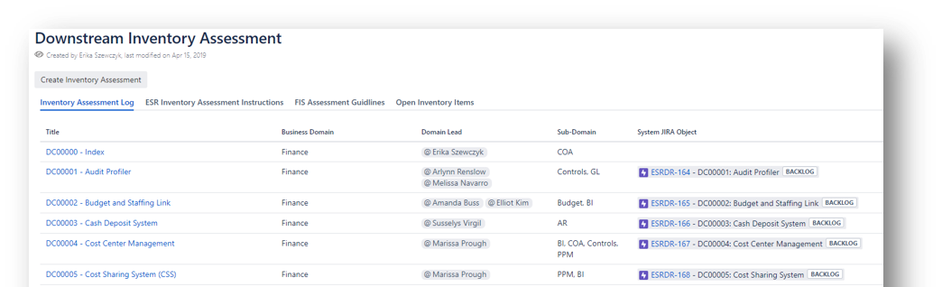
Downstream Inventory Update
Design Leads and IT Services have been working with departments to identify systems and processes that consume or feed financial data. Based on information collected from departments via the Data Use Inventory and one-on-one meetings, the team has built a comprehensive inventory of interfaces that are necessary to support the future-state business processes.
Over the next several months, the project team will continue to share information about the new Chart of Accounts, system integrations or remediation options, and future-state business processes. Departments will be able to understand the impacts to their systems and continue developing plans which align with the Financial Information System project timeline. Learn more about ESR Continuity Planning here.

Slide 11
Next Month
Travel and Procurement Tool Decisions
FIS Reporting & Analytics Strategy

